Slide 1



SAVEETHA SCHOOL OF ENGINEERING
SAVEETHA INSTITUTE OF MEDICAL AND TECHNICAL SCIENCES
COURSE:
CSA1580 CLOUD COMPUTING FOR BIG DATA ANLYTICS FOR CLOUD API
NAME OF THE PROJECT:
Design And Implement a Scalable And Cost
-Effective Web Application On AWS
FACULTY NAME: Dr. Gnana Soundari
By,
G Jagadeesh Satya Sai
192210228

Slide 2
INTRODUCTION
Architectural Design: Creating a robust architecture starts with understanding your application's requirements and expected workload. AWS CloudFront for content delivery, ensuring your application can handle varying levels of traffic efficiently.
Scalability: AWS provides the flexibility to scale resources up or down based on demand. This elasticity ensures a seamless user experience during peak times while optimizing costs during periods of lower demand.
Cost Optimization: Cost efficiency is crucial in cloud environments. AWS offers tools like AWS Cost Explorer and AWS Budgets to monitor. Utilizing Reserved Instances or Spot Instances for predictable or bursty workloads respectively, along with AWS Lambda, helps reduce operational costs by only paying for actual usage.
Security and Compliance: Protecting your application and data is paramount. AWS provides a comprehensive set of security services such as AWS Identity and Access Management (IAM), encryption services, and network security features.
Monitoring and Optimization: Continuous monitoring and optimization are essential for maintaining application performance and cost efficiency over time.

Slide 3
FEATURES:
Auto Scaling: Automatically adjusts the number of EC2 instances or containers in response to changes in demand. This feature ensures your application has enough capacity to handle traffic spikes without over-provisioning, thereby optimizing costs.
Managed Database Services: AWS offers managed database services like Amazon RDS (Relational Database Service), Amazon DynamoDB (NoSQL database), and Amazon Aurora (MySQL and PostgreSQL-compatible relational database)..
Security and Compliance: Implement AWS IAM (Identity and Access Management) for granular control over access to AWS services and resources. Utilize encryption services such as AWS KMS (Key Management Service) to protect data at rest and in transit
Application Monitoring and Logging: AWS CloudWatch monitors your AWS resources and applications in real-time, collecting and tracking metrics, logs, and events.
Cost Management Tools: AWS provides tools like AWS Cost Explorer, AWS Budgets, and AWS Trusted Advisor to monitor, analyze, and optimize costs. These tools help you understand your usage patterns, identify cost-saving opportunities, and set budgetary limits to control expenditures effectively.

Slide 4
ABSTRACT
Project Overview: This project aims to design and implement a robust backup and recovery solution for iCloud data leveraging Amazon Web Services (AWS) infrastructure. The solution focuses on ensuring data integrity, availability, and security while adhering to Apple's stringent privacy standards.
Key Challenges Addressed: The primary challenges include securing sensitive iCloud data during backup and transmission, implementing efficient recovery processes to minimize downtime, and ensuring compliance with global data protection regulations such as GDPR and CCPA.
Proposed Solution: The proposed solution includes implementing strong encryption protocols for data at rest and in transit, utilizing AWS services like S3 for scalable storage, and designing automated backup schedules and recovery mechanisms to enhance operational efficiency and reliability.
Expected Outcomes: By the project's conclusion, we anticipate delivering a secure and scalable backup and recovery solution that enhances data resilience for iCloud users. This solution aims to improve overall service reliability, mitigate risks associated with data loss, and uphold user trust in iCloud's data management capabilities.

Slide 5
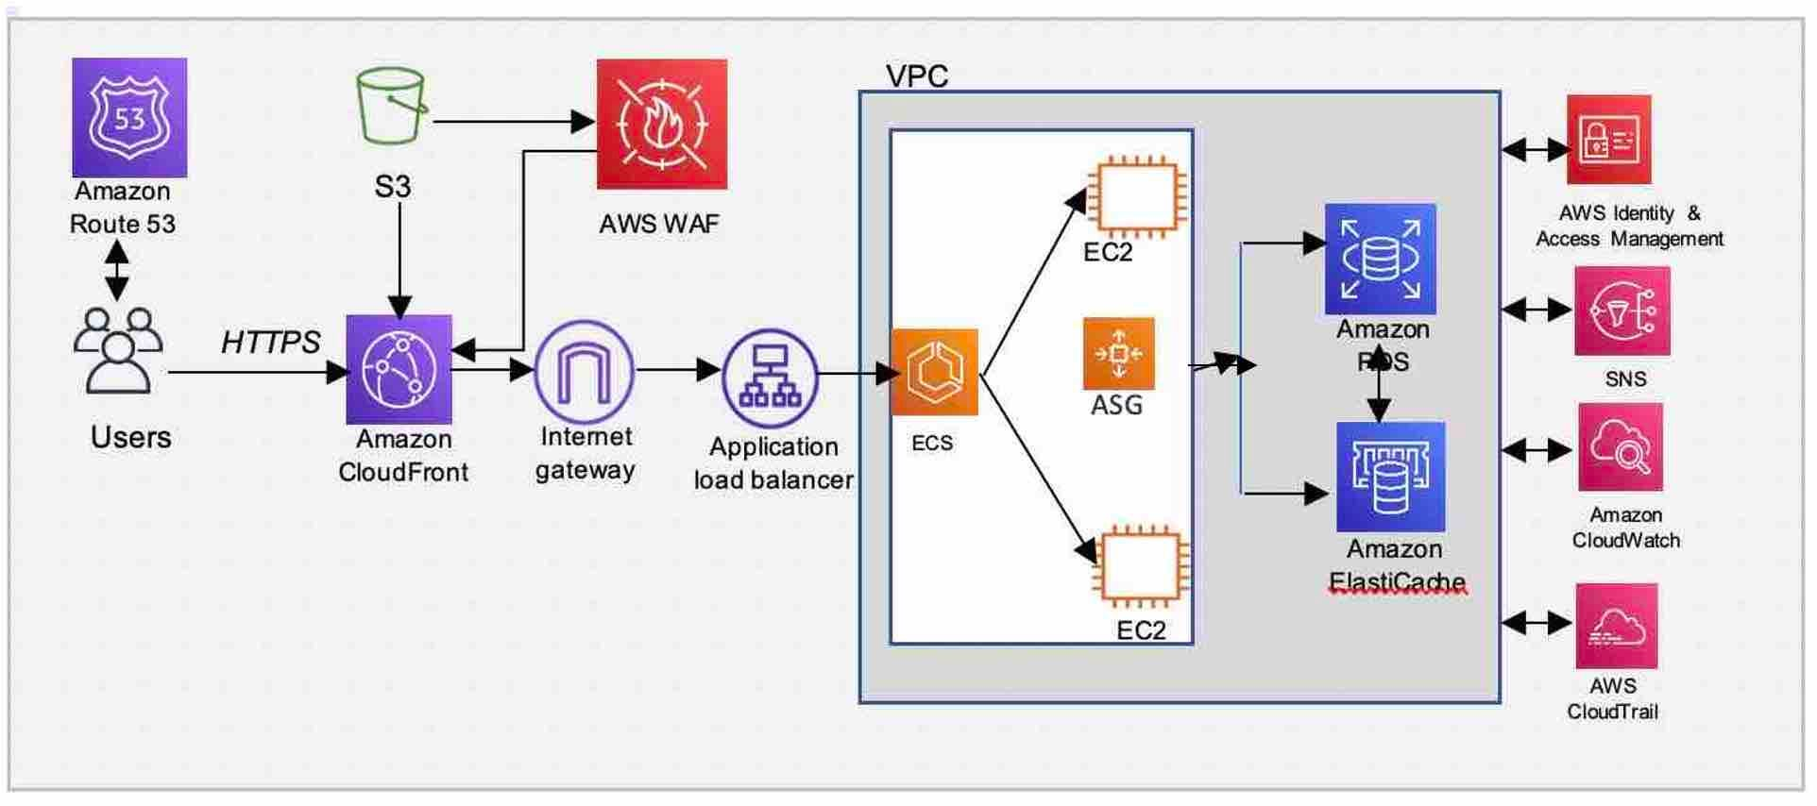

Slide 6
RESULT
Optimized Resource Management: Leveraging AWS services like Auto Scaling, Elastic Load Balancing, and serverless computing ensures efficient resource allocation based on demand, minimizing over-provisioning and reducing operational costs.
Continuous Optimization and Monitoring: Utilizing AWS Cost Explorer, CloudWatch, and DevOps practices enables continuous monitoring, cost optimization, and agile development cycles, ensuring the application remains responsive, secure, and cost-effective over time.
In conclusion, designing and implementing a scalable and cost-effective web application on AWS involves harnessing a rich array of services and best practices tailored to optimize performance and efficiency. AWS Lambda enable applications to seamlessly handle varying workloads while minimizing costs through efficient resource utilization. Managed database services, content delivery networks, and storage options further enhance scalability and reduce operational complexities.

Slide 7
CONCLUSION
Scalable Architecture: Utilize AWS services like Auto Scaling, Elastic Load Balancing, and serverless computing (AWS Lambda) to dynamically adjust resources based on demand, ensuring the application remains responsive under varying workloads.
Cost Optimization: Implement cost-effective strategies such as leveraging Reserved Instances, Spot Instances, and serverless computing to optimize resource usage and reduce operational expenses without sacrificing performance.
Managed Services: Utilize managed database services (Amazon RDS, DynamoDB), storage options (Amazon S3, EBS), and content delivery networks (CloudFront) to offload operational tasks, improve reliability, and enhance scalability while controlling costs.
Monitoring and Continuous Improvement: Utilize AWS CloudWatch for real-time monitoring of performance metrics, set up alerts for proactive management, and employ DevOps practices (CI/CD pipelines) to iterate quickly, improve deployment reliability, and optimize resource usage over time.

Slide 8


